Slide 1

Stock Price Prediction
Department of Computer Science and Engineering Rajkiya Engineering College Kannauj
By : Under Supervision of :
Mukesh Sharma(1883910907) Mr. Naveen Tiwari
Bhasupal Kharwar(1883910902) Asst. Professor
Diksha(1883910903)

Slide 2
Objective
The primary objective of the work is to develop a robust
framework to predict stock price movement based on stock
price data from National Stock Exchange (NSE) at 5minute
intervals.
Our reasoning is that such a granular approach can model
underlying dynamics and be geared to immediate forecasting
of stock price movement.

Slide 3
INTRODUCTION
A stock market is a public market for the trading of company stock.
Stock market allows us to buy and sell units of stocks (ownership) of a company.
If the company’s profits go up,then we own some of the profits and if they go down, then we lose profits with them.
● If more sellers than buyers , stock prices tend to fall. Conversely, when
more buyers than sellers, stock prices tend to rise.

Slide 4
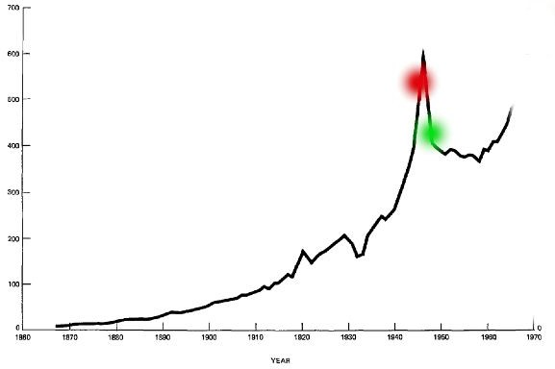
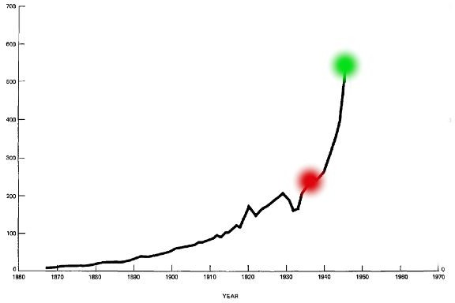
Loss
Profit
Red is purchased stock Green is sold stock

Slide 5
Analytical Goals
To collect the historical stock price data related to different companies.
Cleaning the data.
Calculating the performance indicators for stocks and use them as faetures for our model.
Applying different machine learning models to verify their usefulness.
Applying recurrent neural networks(LSTM regressor) to predict the price.

Slide 6
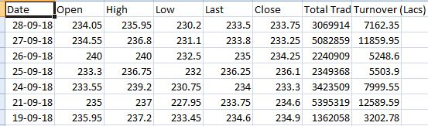
HOW TO READ A STOCK TABLE?
Date- day on which the stock is traded
High- high is the highest price at which a stock traded during the course of the day
Close- refers to the last price at which a stock trades during a regular trading session
Open- price of the
first trade for any listed stock is its daily opening price.
Low- lowest price at which a stock trades over the course of a trading day.

Slide 7
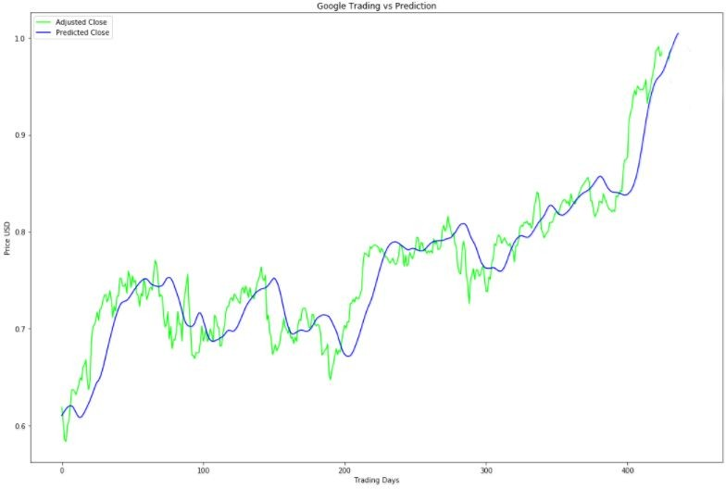


PROBLEM STATEMENT
Predicted Close price of Next day
To accurately predict the
future closing value of a given stock across a given period of time in the future.
Today’s Close price
Use learning models compare
different machine and deep learning
available and them to verify that
usefulness.
Actual Close
Predicted Close
5

Slide 8
DATASET
The data used in this project is of the NSE-TATAGLOBAL from 27-07-2010 TO 28-09-2018 this is a series of data points indexed in time order or a time series. Our goal was to predict the closing price for any given date after training
6

Slide 9
FEATURE IMPORTANCE
Process of selecting a subset of relevant features for use in model construction.
Feature selection methods include and exclude attributes present in the data without changing them.
Here, in our case ‘Date’,‘High’ and ‘Low’ attributes are dropped.
Dropped
7

Slide 10
APPROACHES TO SOLVE
Long Sort Term Memory (LSTM)
11

Slide 11
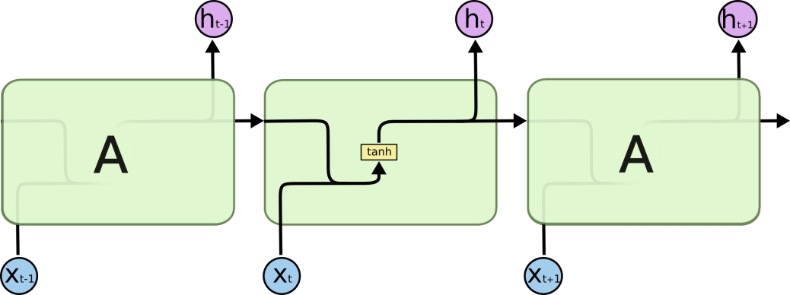

LSTM
LSTM (Long Short Term Memory)
LSTMs are explicitly designed to avoid the long-term dependency problem. Remembering information for long periods of time is practically their default behavior, not something they
struggle to learn!
Recurrent Neural Network
LSTM

Slide 12
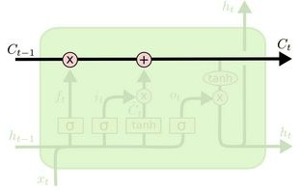
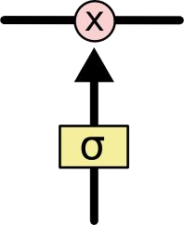
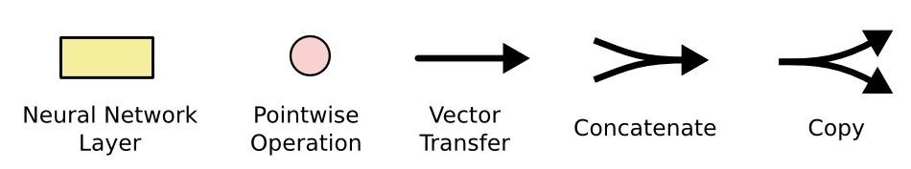
LSTM (How it works?)
The key to LSTM is the Memory cell state which stores the information. It runs straight down the entire chain.
LSTM has the ability to remove or add information to these cell state, regulated by structures called gates.
Gates are composed of sigmoid neural net layer and a multiplication operation.
Sigmoid layer outputs zero or one.
There are three gates to protect and control the cell states.
○ forget gate
○ input gate
○ output gate
Multiplication operation
Sigmoid layer

Slide 13
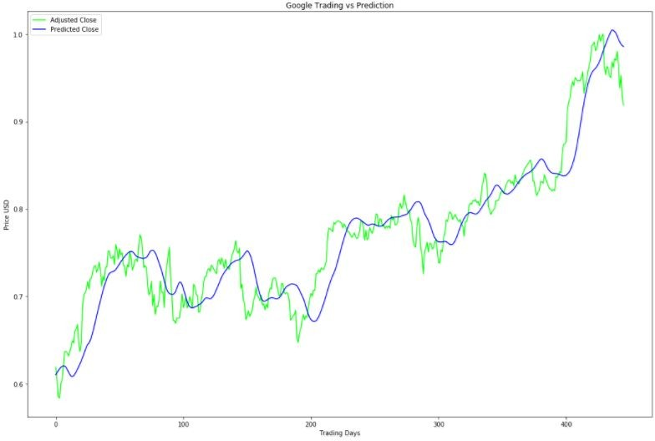

Slide 14
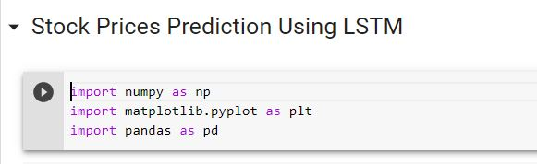
There are some Code

Slide 15
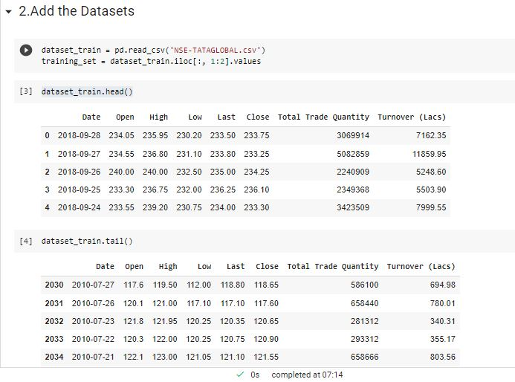
ADD THE DATA SETS

Slide 16
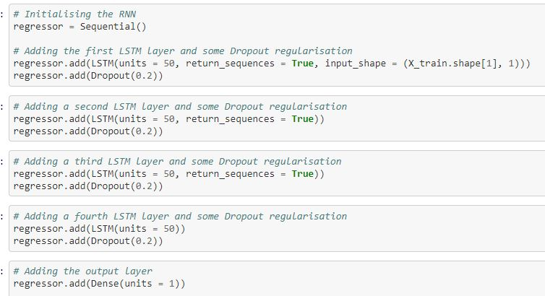
Training neural network
The model here are RNN and LSTM based model for the prediction of stock prices The data is fed to the neural network and trained for prediction assigning random bias and weights.
In this the model composed of sequential Input layer followed by three LSTM layer and a dense layer with activation and finally a dense output layer with linear activation function.

Slide 17
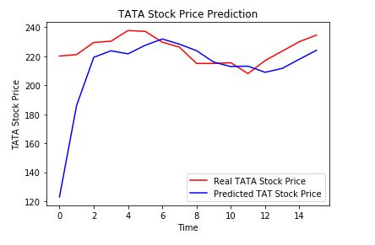
Visualization and Results
A rolling analysis of a time series model is often used to assess the model’s stability over time.
when analyzing financial time series data using a statistical Model, a key assumption is that the parameters of the model are constant over time. Here we are using Iloc to select rows and columns by in order they are appear in the data frame.
To get the Predicted value we are going to merge the train dataset and test dataset on zero axis. And reshape the data.

Slide 18
Literature Survey
Stock market prediction using neural network through news on online social networks: [5] In theory, RNNs can make use of the information in arbitrarily long sequences, but in practice they are limited to looking back only a few steps. The vanishing gradient problem prevents standard RNNs from learning long-term dependencies. Gated Recurrent Units (GRUs) were proposed.
Stock market's price movement prediction with LSTM neural networks: [1] The objective of this project is to study the applicability of recurrent neural networks, in particular the LSTM networks, on the problem of stocks market prices movements prediction. Assess their performance in terms of accuracy and other metrics through experiments on top of real life data and analyze if they present any sort of gain in comparison to more traditional machine learning algorithms.
A LSTM-based method for stock returns prediction: A case study of China stock market: [2] In our LSTM model for stock prediction, one sequence was dened as a sequential collection of the daily dataset of any single stock in a fixed time period (N days). The daily dataset describes the performance of the stock with sequence learning features like closing price, trade volume on one particular day in these N days.

Slide 19
CONCLUSION
In this project, I have demonstrated a machine learning approach to predict stock market trend using different neural networks. Also, with T test result analysis I can conclude that LSTM performs better compare to Backpropagation and SVM. For this implementation, I would like to conclude that if I incorporate all the factors that affect stock performance and feed them to neural network with proper data preprocessing and filtering , after training the network I will be able to have a model which can predict stock momentum very accurately and this can result into better stock forecasting and profit for financial firms.

Slide 20
References
[1] J. Sen, "A robust analysis and forecasting framework for the Indian mid cap sector
using time series decomposition," Journal of Insurance and Financial Management,
vol 3, no 4, pp 1- 32, 2017.
[2] J. Sen and T. Datta Chaudhuri, "Understanding the sectors of Indian economy for
portfolio choice," International Jouranl of Business Forecasting and Marketing Intel-
ligence, vol 4, n0 2, pp 178-222, 2018.
[3] S. Basu, "The relationship between earnings yield, market value and return for NYSE
common stocks: further evidence," Journal of Economics, vol 12, no 1, pp. 129 - 156,
1983.

Slide 21
THANK YOU!
30

